Slide 1
Final TTCS System Proposal for Orenda Marine Engines
by JGRC Consulting

Slide 2

Introduction
JGRC Consulting
Corey Despres – Project Manager
Graeme McBriarty – Analyst
Ryan Vaughan - Analyst
Ryan

Slide 3
Introduction
Our Task
Analyze the current system and identify the major issues
Build a brand new system from the ground up
Develop a system that will fix the major issues
Ryan

Slide 4
Introduction
Major Issues Identified with the current system
Break down in communication causing inefficiencies
Lack of reporting
Lack of accountability
Slow manual processes
Ryan

Slide 5
Introduction
Agenda
Our proposed system
Implementation plan
Hardware overview
Costs vs Benefits analysis
Ryan

Slide 6
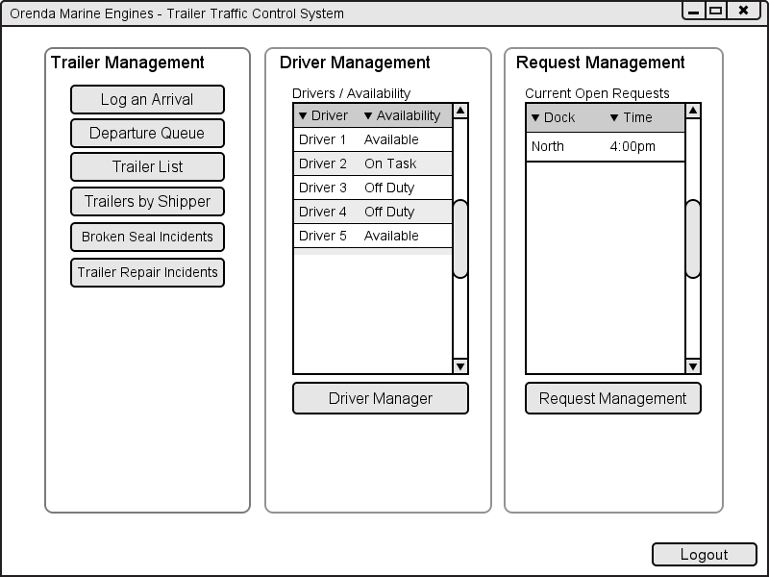
Intro to Dispatcher Dashboard
Page 7
Figure 1-1
Corey

Slide 7
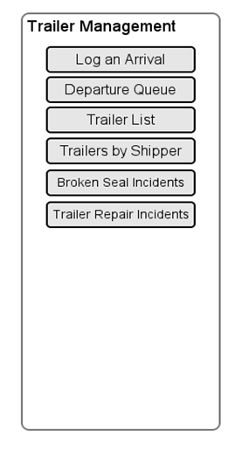
Trailer Management
Log arrivals
Mark departures
Manage trailers
View trailer information
Corey

Slide 8
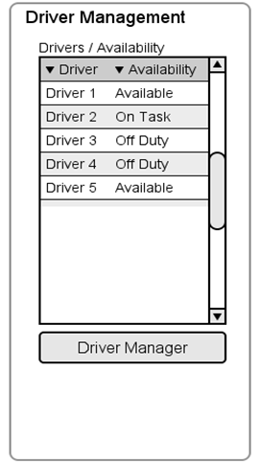
Driver Management
Lists all On-Site Drivers
Allows the Dispatcher an easy way to know how many Drivers are available
Corey

Slide 9
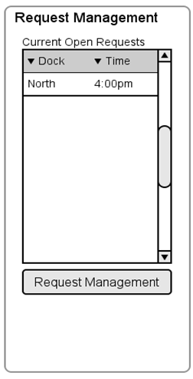
Request Management
Contains a List of all Unhandled requests from the dock foremen
Requests with the soonest delivery time take priority
Corey

Slide 10

Trailer Arrivals
Corey

Slide 11
Trailer Arrival
A trailer arrives at the Orenda Facility and pulls up to the dispatch office
The dispatcher receives the bill of lading from the driver
The dispatcher compares the trailer number and seal number to the one on the bill of lading
Corey

Slide 12
Dispatcher Dashboard
Page 7
Figure 1-1
Corey

Slide 13
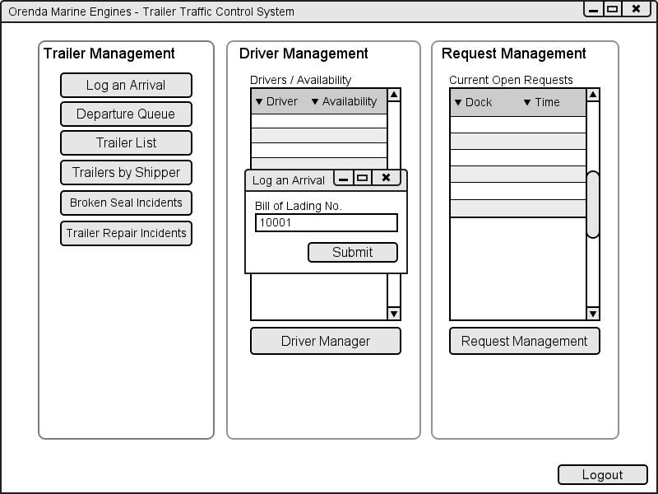
Log Trailer Arrival
Page 10
Figure 1-3
The Bill of Lading is sent through electronically prior to the trailers arrival
Dispatcher enters the number on the bill of lading to bring up the correct trailer
Corey

Slide 14
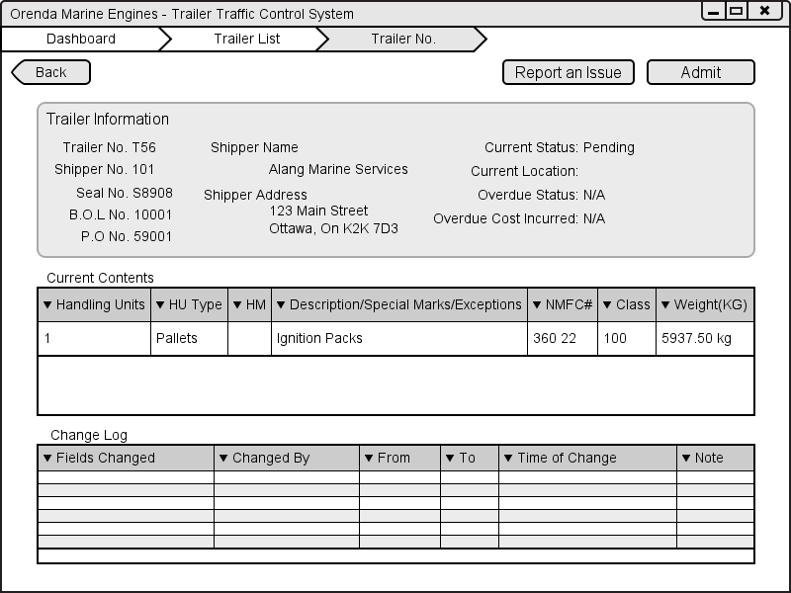
Trailer Admission
Page 14
Figure 1-5
Contains all of the trailer information from the Bill of Lading
The dispatcher compares the bill of lading to the information on the screen
If there are any problems with the two he can click the report an issue button and make any notes or changes
Corey

Slide 15
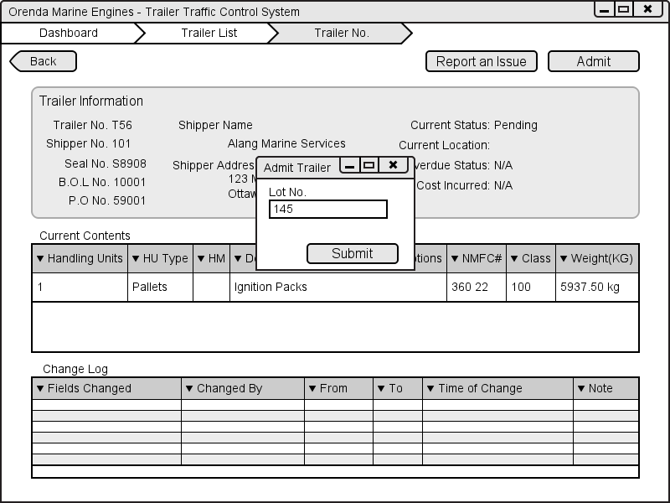
Choosing Parking Spot
The admit trailer dialog is used to tell the system where the trailer will be parked.
The dispatcher can manually type the lot number or select it on the yard map.
Corey

Slide 16
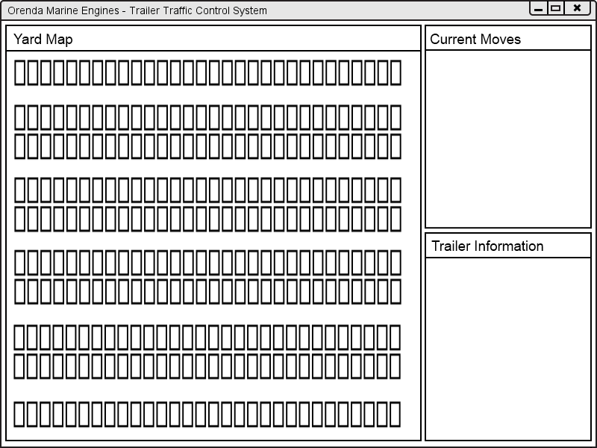
Yard Map
Page 23
Figure 1-10
Yard map is a dynamically updated screen that is a representation of the yard.
A list of current moves and trailer information is displayed on screen.
Free lots are represented by number, Trailers with a move are blue, trailers needing repair or broken seal are red
Corey

Slide 17
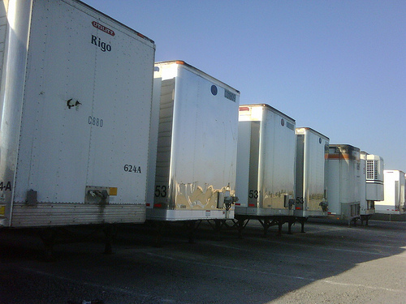
Requests for Trailer Movements
Corey

Slide 18
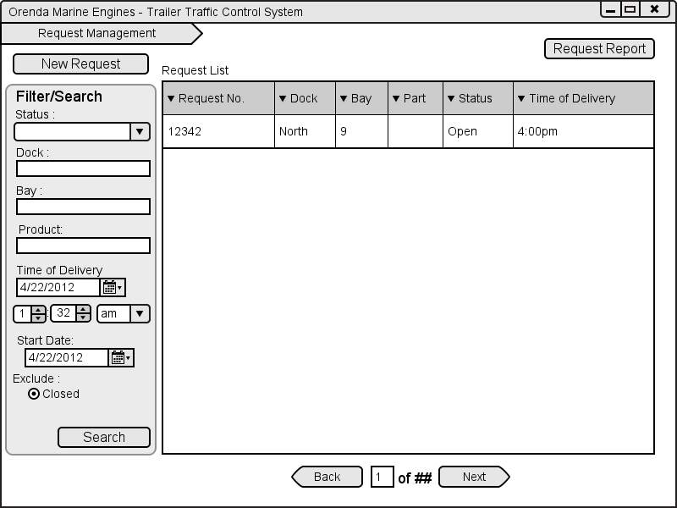
Requests – Dock Foreman
Page 37
Figure 2-1
Contains a list of all request from the currently logged in foreman
The foreman can search using and of the filters available
New requests can be created by selecting the new requests button
Corey

Slide 19
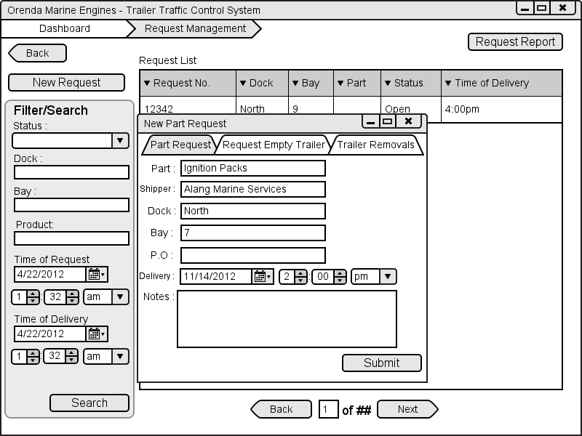
Requests – Dock Foreman Cont.
Page 40
Figure 2-2
The dock foreman can make 3 types of requests Part Request, Request for an Empty trailer and a Trailer removal request.
Dispatcher can make a request using different combinations of materials, not everything is required
Corey

Slide 20
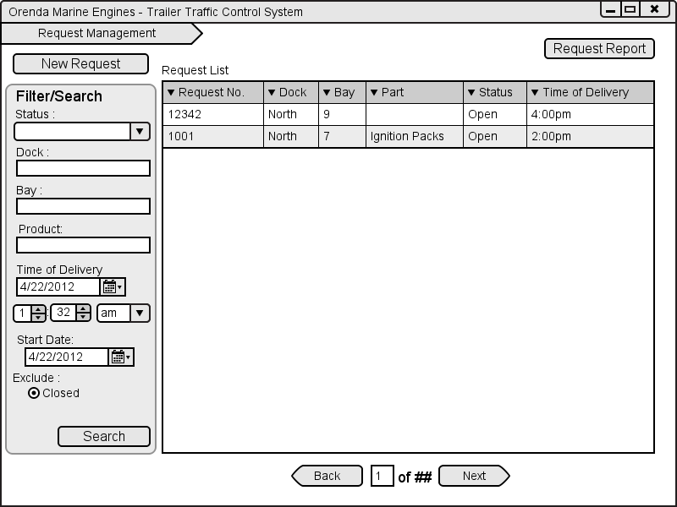
Requests – Dock Foreman Cont.
Page 37
Figure 2-1
Corey

Slide 21
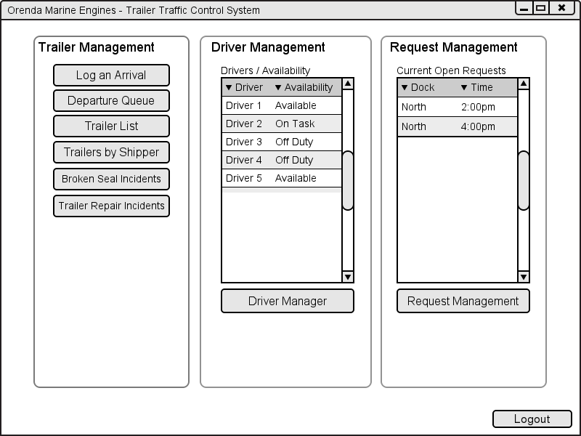
Requests – Dispatcher
Page 7
Figure 1-1
Corey

Slide 22
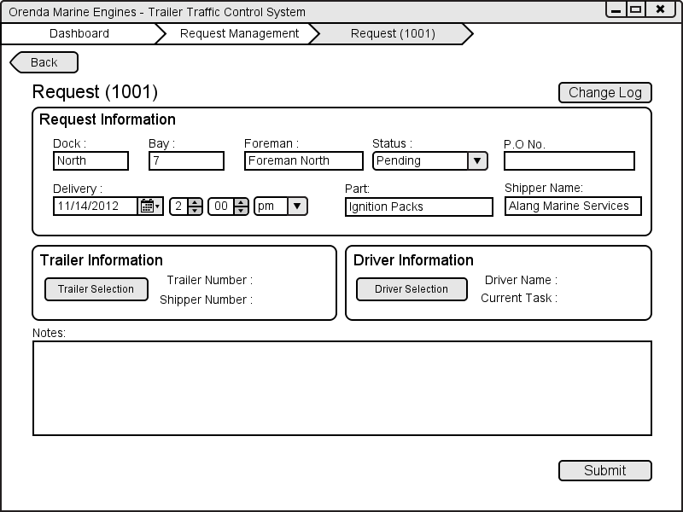
Requests – Dispatcher cont.
Page 28
Figure 1-13
The dispatcher request screen contains all of the information that was entered by the dock foreman
The dispatcher assigns a trailer by selecting the trailer information and assigns a driver by selecting the driver selection button
Corey

Slide 23
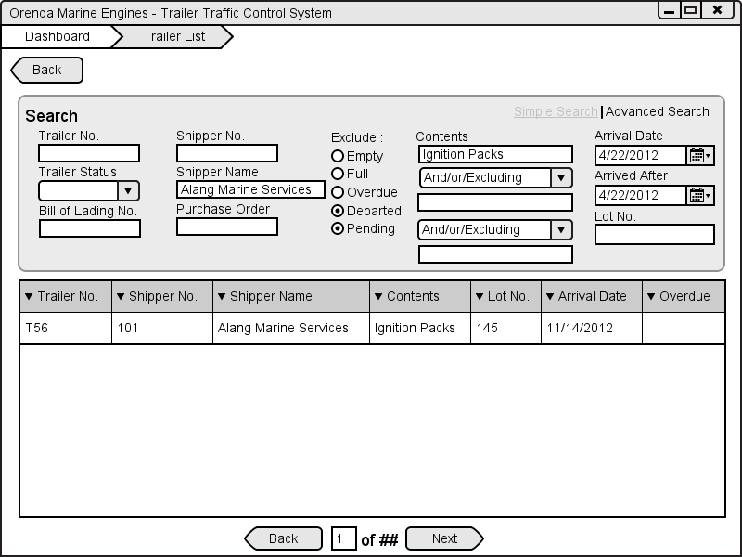
Requests – Dispatcher cont.
Page 11
Figure 1-4
The trailer list contains a list of all trailers that match the search criteria
By default the list is sorted by the information entered into the request
Corey

Slide 24

Requests – Dispatcher cont.
Page 30
Figure 1-14
Corey

Slide 25
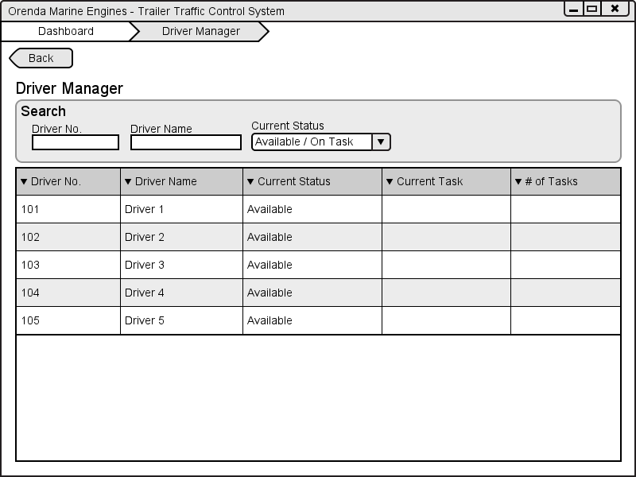
Requests – Dispatcher cont.
Page 24
Figure 1-11
The driver list contains all drivers that are current on the job at Orenda regardless of their status
The dispatcher can filter drivers as needed
By selecting the number of tasks the dispatcher can see a list of all tasks assigned to the driver.
Corey

Slide 26
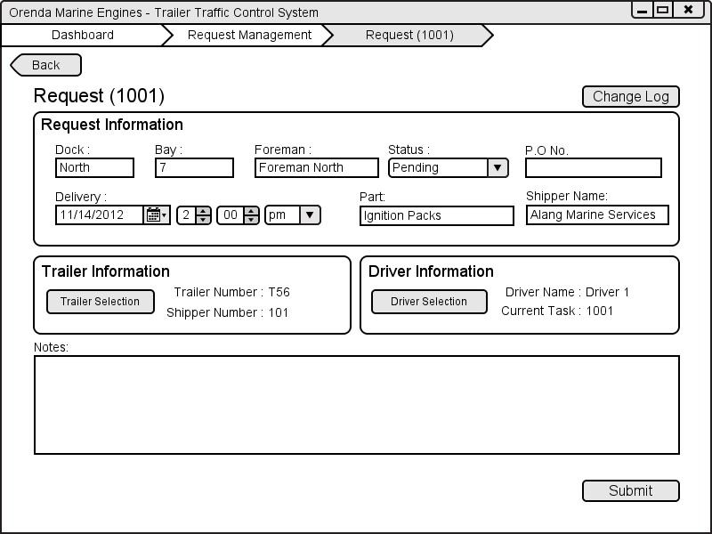
Requests – Dispatcher cont.
Page 30
Figure 1-14
Corey

Slide 27

Driver Task Tracking System

Slide 28
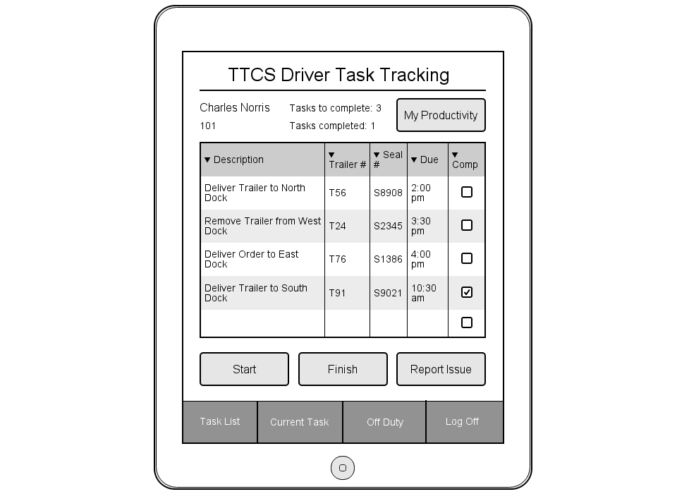
Task List View
Page 47
Figure 3-2
Main Screen for app
Daily statistics with personalized information
Grid with list of today’s tasks. Shows information necessary to begin a task.
Start a task from this view, finish it, or Report an issue identified before beginning.
Menu options for switching views, going off duty or logging off.
Ryan

Slide 29
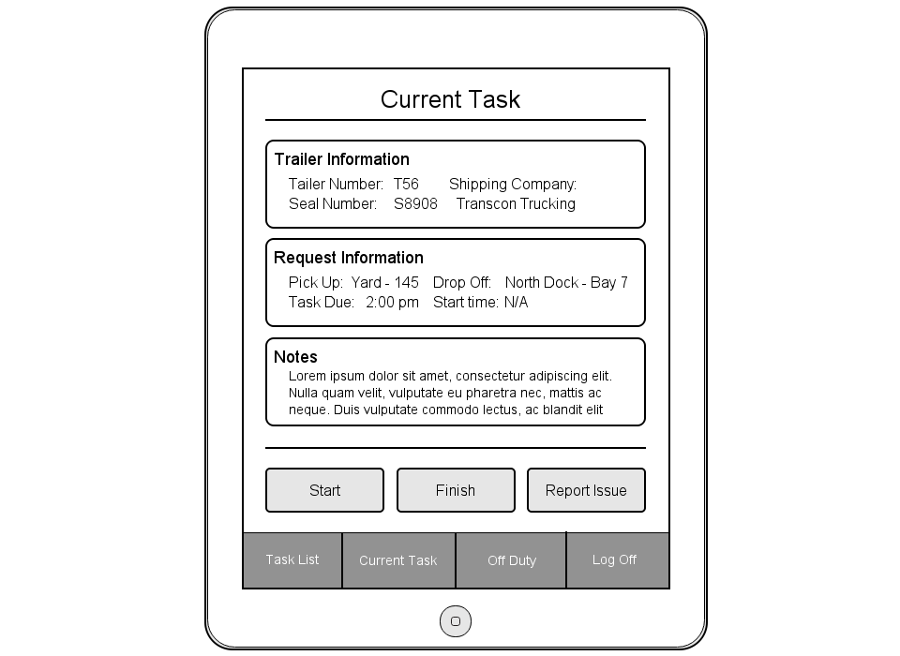
Current Task View
Page 49
Figure 3-3
Trailer Information displays information necessary to identify the trailer needed for this request
Request information displays the details of the request; when and where you need to be
Notes contains any additional notes added by either Dock Foreman or Dispatcher
Finish your task from here or Report an issue on it.
Menu options
Ryan

Slide 30
Task List View
Page 47
Figure 3-2
Ryan

Slide 31
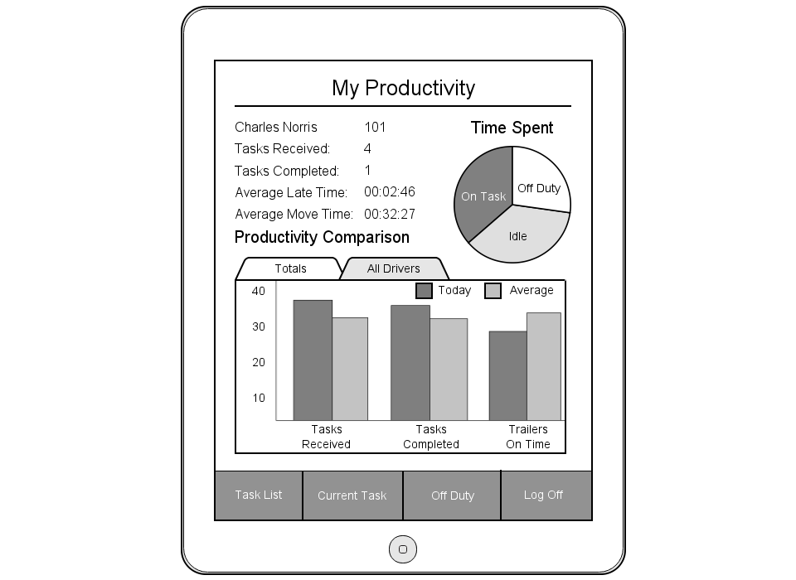
My Productivity
Page 53
Figure 3-6
Personalized information
Daily statistics for trailer deliveries
Pie chart depicting how the driver is spending his/her time
Bar chart displaying the driver’s daily stats in comparison to the averages of all drivers for that day
Menu options
Ryan

Slide 32
Task List View
Page 47
Figure 3-2
Ryan

Slide 33
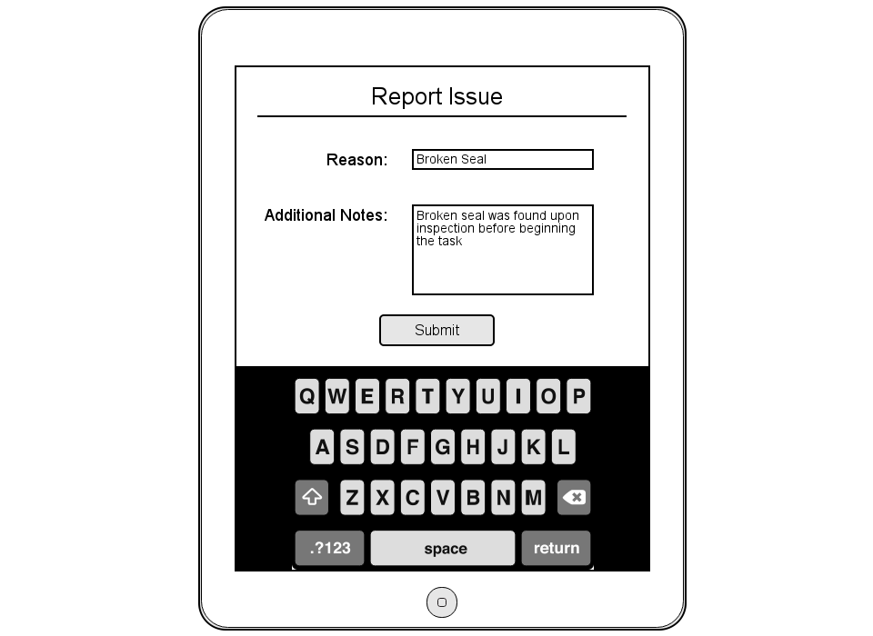
Report Issue
Page 52
Figure 3-5
‘Reason’ field to give a name to your reported issue (i.e. Broken Seal)
Additional notes field to add anything the dispatcher might need to know
Sends entered information to dispatcher along with current task information
Ryan

Slide 34
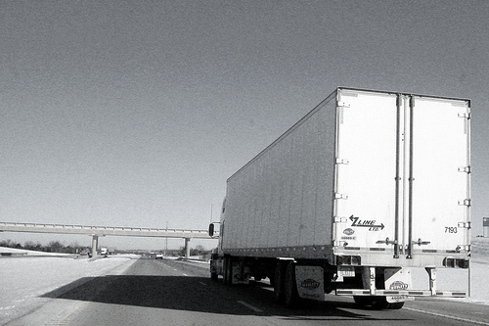
Trailer Departures
Corey

Slide 35
Two Types of Trailer Departures
Departure of an empty trailer
Selected by the dispatcher
Leaves from the yard
Departure of a trailer with product
Is pre-arranged
Can leave from the yard or the dock
Corey

Slide 36
Dispatcher Dashboard
Page 7
Figure 1-1
Corey

Slide 37
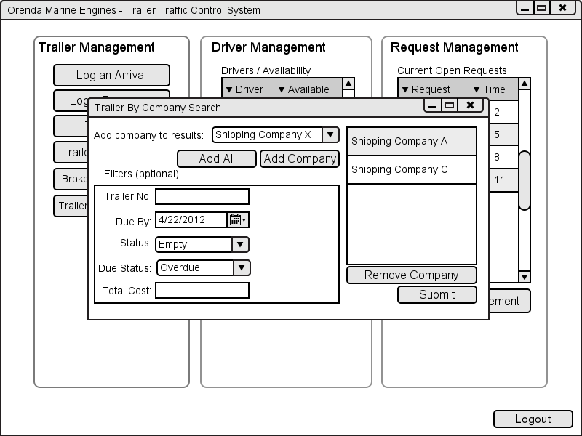
Trailer By Company Filter
Page 32
Figure 1-15
Used to select what companies will be displayed on the Trailer By Shipper List
The dispatcher has the ability to filter out trailers based on different options.
Corey

Slide 38
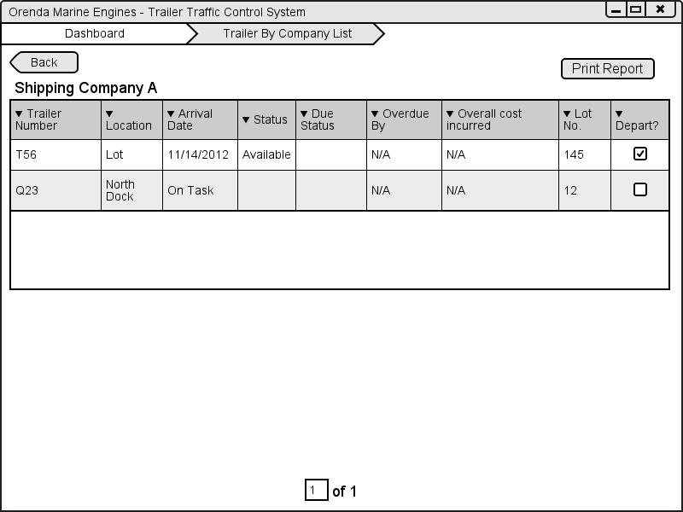
Marking for Departure
Page 34
Figure 1-16
This screen contains a list of all trailers that match the criteria selected on the dialog
Trailers are sorted by oldest to newest
Corey

Slide 39
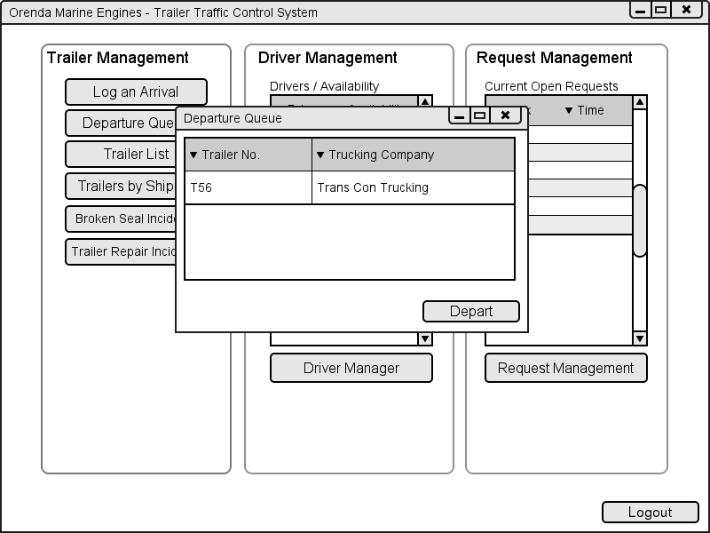
Departure Queue
Page 35
Figure 1-17
Contains a list of all trailers that are marked for departure.
Used by the dispatcher when a trailer returns from the lot with a trailer.
Corey

Slide 40
Trailers Leaving With Product
Trailer can leave from the Dock or the Lot
The Bill of Lading is used to check the trailer
The trailer is marked as departed in the system once it leaves
Corey

Slide 41
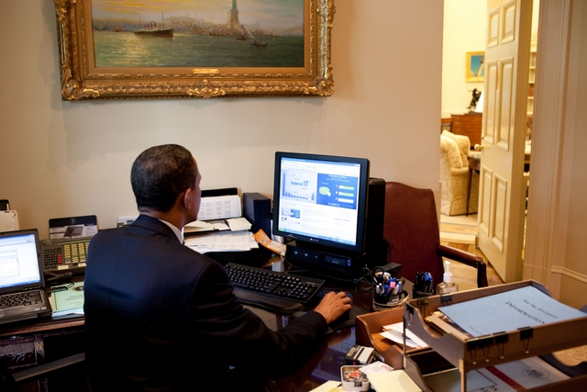
Executive Dashboards

Slide 42
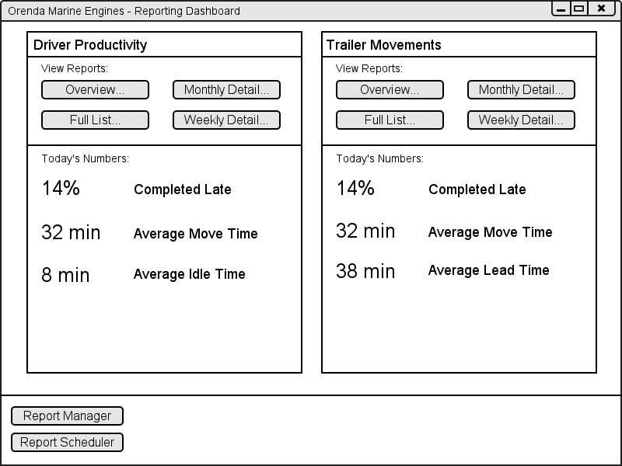
Executive Dashboard
Page 55
Figure 4-1
Graeme

Slide 43
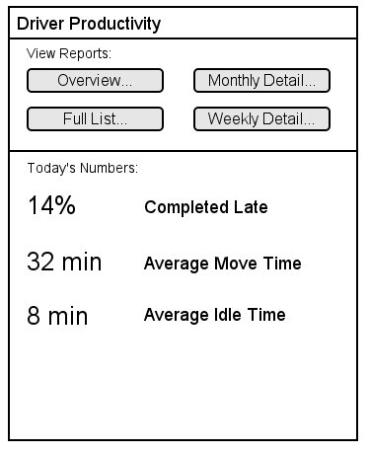
Report Panel Concept
Access to all reports related to a category.
Broad daily statistics.
Fully configurable.
Graeme

Slide 44
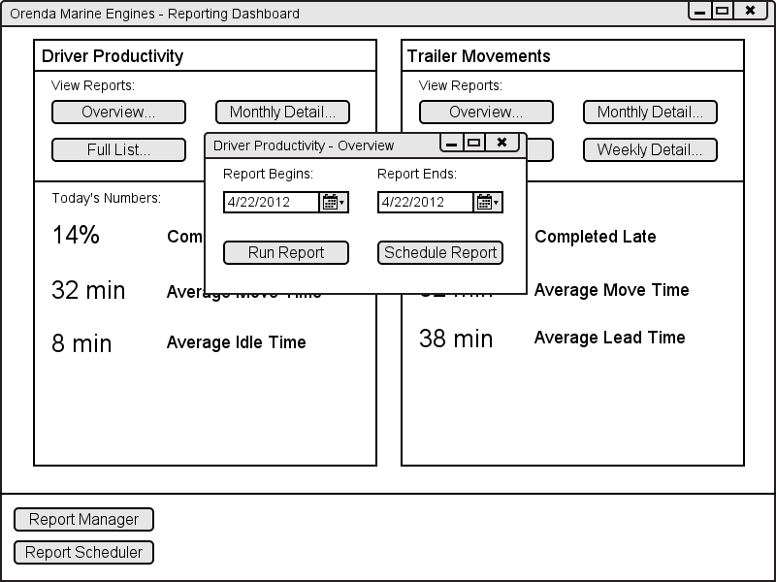
Select a Report
Graeme

Slide 45
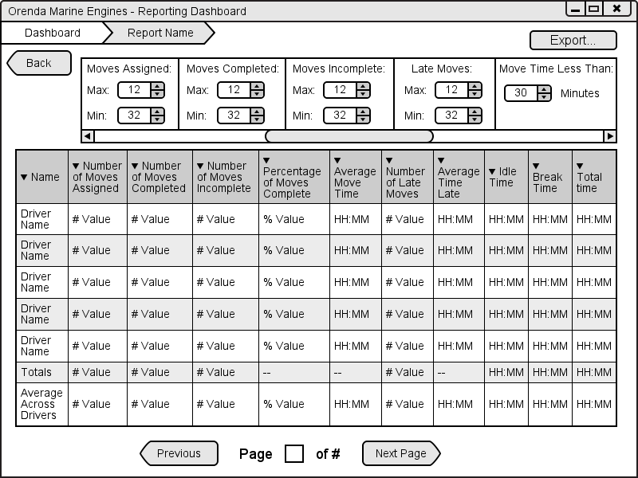
Report View
Page 61
Figure 4-5
Filters depending on report selected.
Sort by any column.
Drill down into more detailed reports.
Print reports based on current view.
Export reports as PDF or spreadsheet.
Graeme

Slide 46
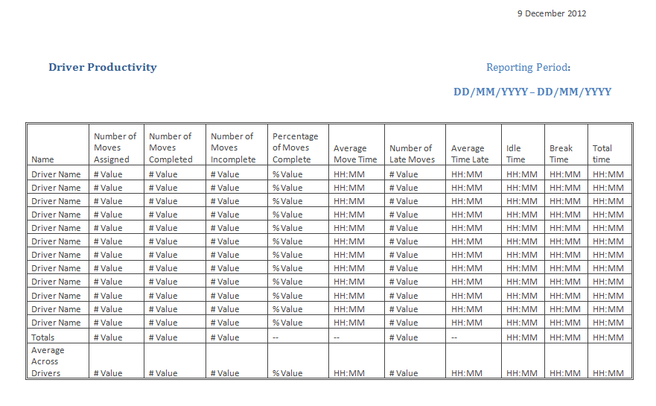
Driver Productivity
Page 62
Figure 4-6
Graeme

Slide 47
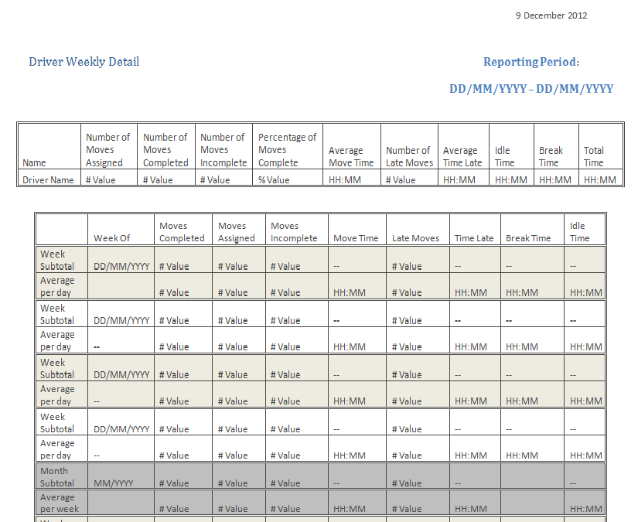
Driver Detail
Page 64
Figure 4-8
Graeme

Slide 48
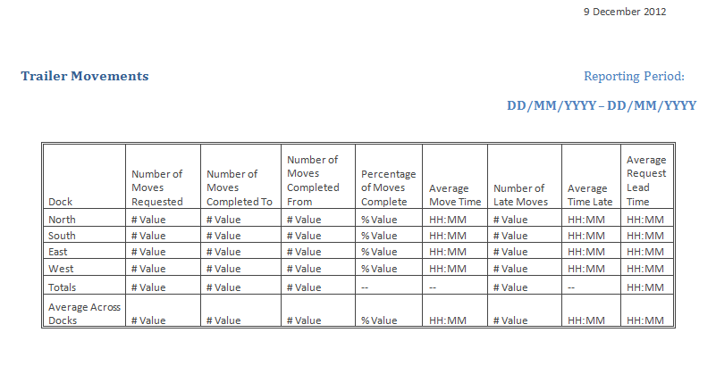
Trailer Movements
Page 65
Figure 4-9
Graeme

Slide 49
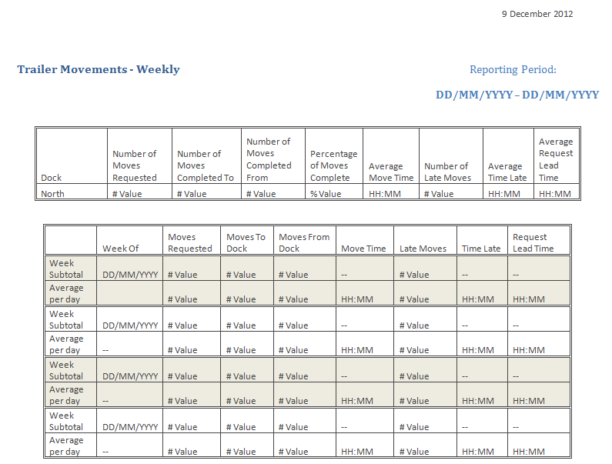
Trailer Movements - Weekly
Page 67
Figure 4-11
Graeme

Slide 50
Additional Reports
Dock Statistics
Request-focused view similar to Trailer Movements
Trailer arrivals and departures
Matches purchase orders, bills of lading to arrivals, departures
Drill down to a full list of every move or incident.
Graeme

Slide 51
Dashboard Features
Report Dashboard Manager used to control the configuration of dashboard and panels.
Report Scheduler used to view and modify scheduled reports.
Graeme

Slide 52
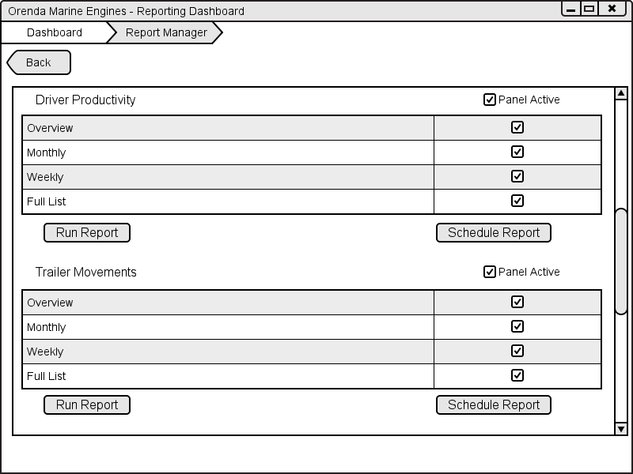
Report Dashboard Manager
Page 57
Figure 4-2
Graeme

Slide 53
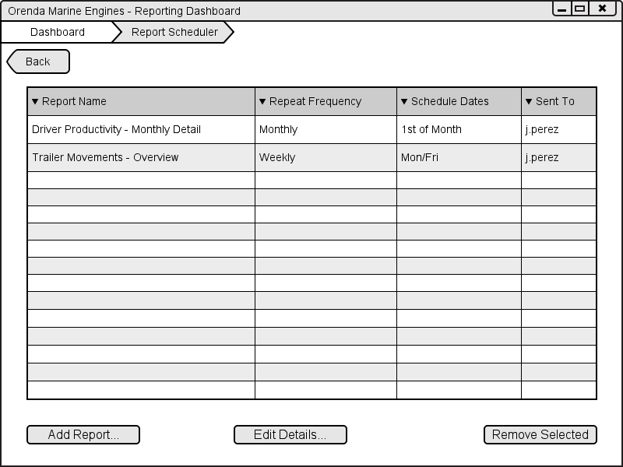
Scheduling
Page 59
Figure 4-3
View all reports that have been saved.
Schedule new reports.
Edit details of existing scheduled reports.
Remove reports from schedule.
Graeme

Slide 54
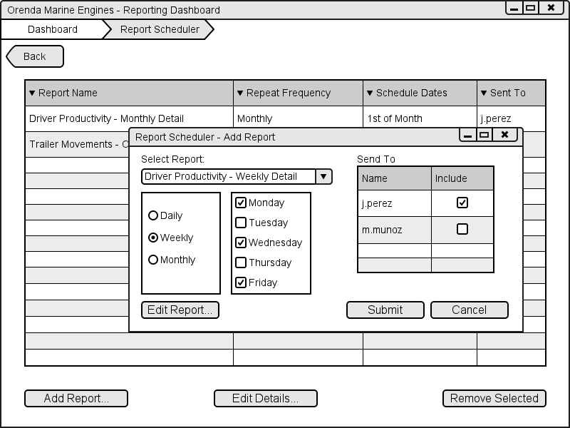
Scheduling
Page 60
Figure 4-4
Graeme

Slide 55
Implementation Plan
Page 70
Development and QA
Installation
Training
Deployment
Graeme

Slide 56
Development
Page 72
Agile development methodology
Daily morning scrums
Progress updates every week at minimum
Deliver working sections and prototypes of the system
16 weeks – QA begins 2 weeks after development
Graeme

Slide 57
Quality Assurance
Page 72
QA team working closely with developers
Identifying issues before they can become a problem
User Acceptance Testing during training – 1 week
Graeme

Slide 58
Networking, Hardware and Software Installation
Page 72
Overlaps the ending of the QA and development phase
Networking infrastructure – 2 weeks
Hardware – 1 week
Software deployment can begin as soon as development is finished
Software – 1 week
Graeme

Slide 59
Training
Page 72
Dispatchers – 2 weeks of training each
Dock foremen – 1 week each
Executives – 1 week each
Drivers – 2 weeks total 3 drivers / day
Graeme

Slide 60
Final Deployment and Activation
Page 73
One month of running systems together, during training, with mock data.
Two weeks of live data, systems running together.
Graeme

Slide 61

Hardware and Equipment

Slide 62
Hardware Overview
Page 74 - 81
Dispatchers will be receiving desktop workstations with dual monitors to allow for the Yard map to be displayed alongside the application
Dock foreman's will be receiving a desktop workstation, one will be placed in each dock for each foreman to use.
The executives will be given laptops to use for report generation as well as a printer for the ability to get the printed reports as they are needed
An onsite server will be used to run the database. As well as a separate hard drive backup
Drivers will be receiving Galaxy Tab II 7.0 with mounts for inside of the tractors.
The yard is be blanketed by wireless connection using access points stationed around the facilities
Corey

Slide 63
Cost/Benefits Analysis

Slide 64
Costs
Page 82
Figure 7-1
Labour
$161,360
Development
Material
$1,906.7
Tablet Cases
Hardware
$25,119.98
Dispatcher, Dock Foreman and Executive computers/work stations
Training
Implementation
Tablet Mounts
RFID ID Cards
Networking Gear
Fiber optics installation
Total Cost
$188,386.68
Ryan

Slide 65

Benefits
Page 83-84
Figure 7-2.1, 7-2.2
Labour
Dispatcher entering bill of lading - $22,300 per year
Dispatcher entering making requests - $13,400 per year
Driver FTE – 2 per year
Business
Overdue Trailer Savings – $43,200 per year
Phone Plan - $5,800 per year
Reduced Work Stoppage – $72,000 per year
Ryan

Slide 66

Return on Investment
Page 85
Figure 7-3
Year 0 | Year 1 | Year 2 | Year 3 | Year 4 | Year 5
-187,606.68 | 250,421.74 | 217,758.03 | 189,354.81 | 164,656.36 | 143,179.44
-187,606.68 | 62,815.06 | 280,573.09 | 469,927.91 | 634,584.26 | 777,763.71
Ryan

Slide 67
Conclusion
Break down in communication causing inefficiencies
Communication handled through requests
Lack of reporting
Robust reporting system
Lack of accountability
Reports provide trace to root cause
Slow manual processes
Eliminated or automated
Graeme

Slide 68
Questions?

